Slide 1
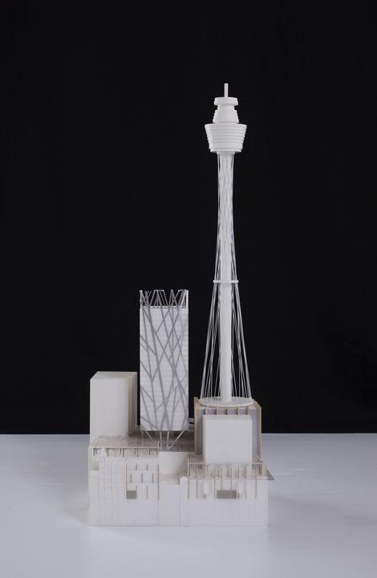
Design Proposal
Creating A Safe Driving Experience With Safe Vehicle Drive
This Photo by Unknown Author is licensed under CC BY-NC-ND

Slide 2
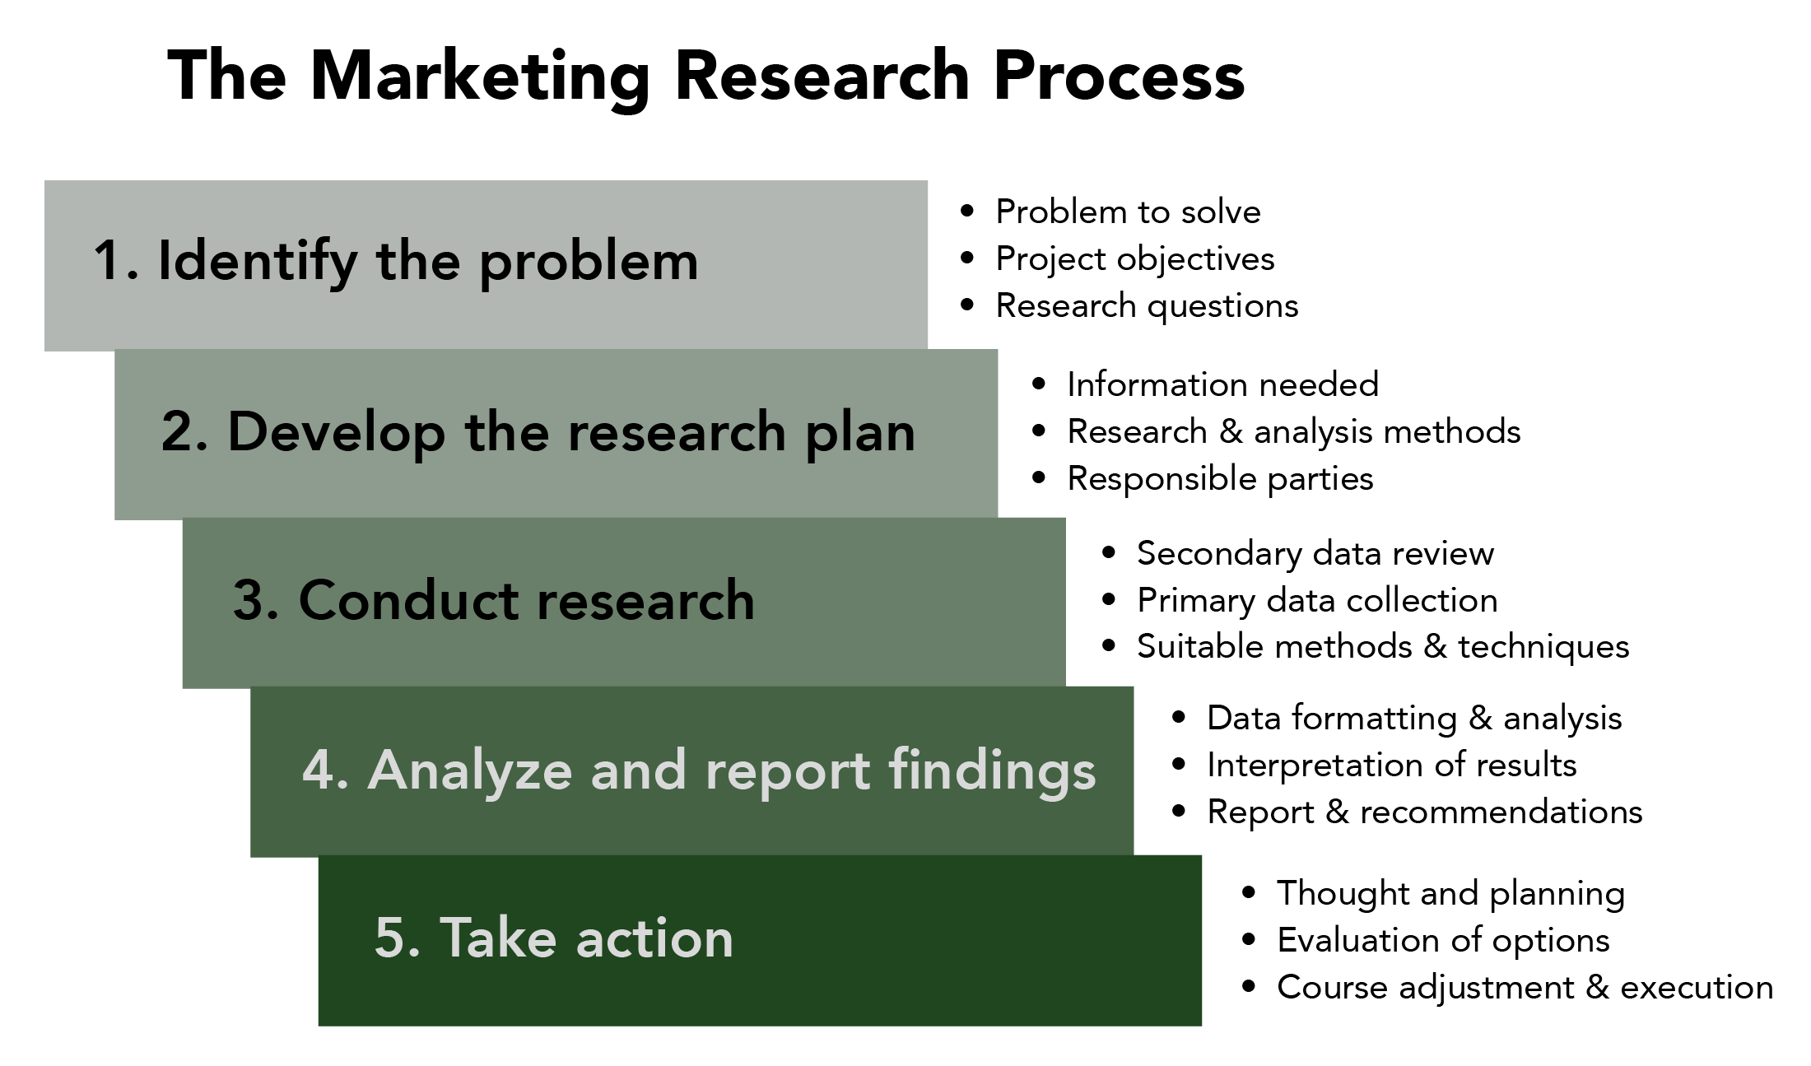

Slide 3
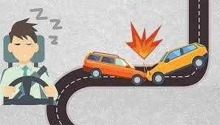
Main problem
This usually happens when a driver has not slept enough, but it can also happen because of untreated sleep disorders or shift work. Worldwide, it is estimated ​that between 20% and 30% of all road crashes are sleep deprivation related.
Any amount of alcohol in your bloodstream can impact your driving ability. The effect of alcohol abuse varies greatly, putting you at risk of causing an accident or highway injury. As per the report, drunken driving was responsible for 8,400 road accidents and 3,322 deaths.
When you are late to an appointment and in a poor mood, most people will begin taking riskier behavior on the road like speeding or swerving between lanes. This type of driving is unsafe and can increase your risk of crashing. Worldwide estimations say that between 10% and 20% of road crashes are mental disorder related.

Slide 4

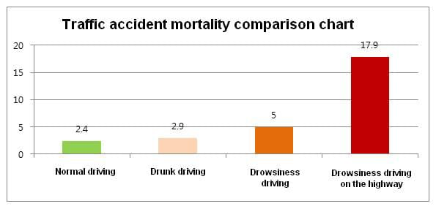

Slide 5
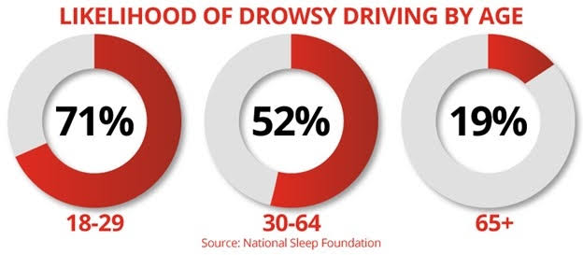
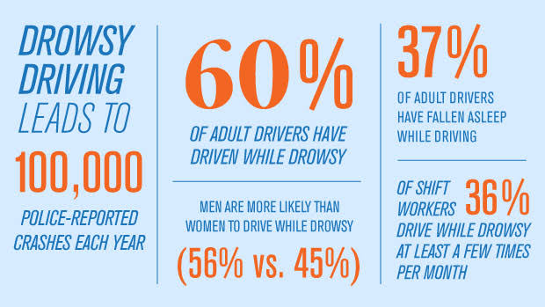

Slide 6
Safe vehicle drive
MOTO-KEEP DRIVERS AWAKE
Company Name: N.S.M.manufacturing co. pvt.ltd

Slide 7
Aim and objective​
To overcome these problems, a complete model of multiple features like antisleeping alert, mental disorder alert, alcoholic alert helps more. We are designing an electronic device which detect these all.
Our Aim is to design an electronic device for Vehicles like- long vehicles such as sleeper buses and long transport vehicles trucks (Car, Pickup etc)setup with complete features helps to control the major accidents, crashes, deaths.
The eye blinks of the driver and estimating the driver status and control the car accordingly. We are implementing the system as a prototype by capturing the live images of the eyes and fed them in to the Microcontroller in which the MATLAB software is used to process the video and convert it in to frames and process it accordingly.

Slide 8
Scope and application
THIS MODEL HAS MAJOR SCOPES ARE –
- This models to reduce the major Road accident/crashes,
- Protect sleepy and alcoholic drivers from road accidents,
- Development in the field of technology,
- Keep drivers awake and alert while on the road,
- This system alerts the user if he/she falls asleep at the wheel thereby,
avoiding accidents and saving lives,
- Turn Off the vehicles engine if he/she will drink or getting mentally
disorder.

Slide 9
Design Concepts

Slide 10
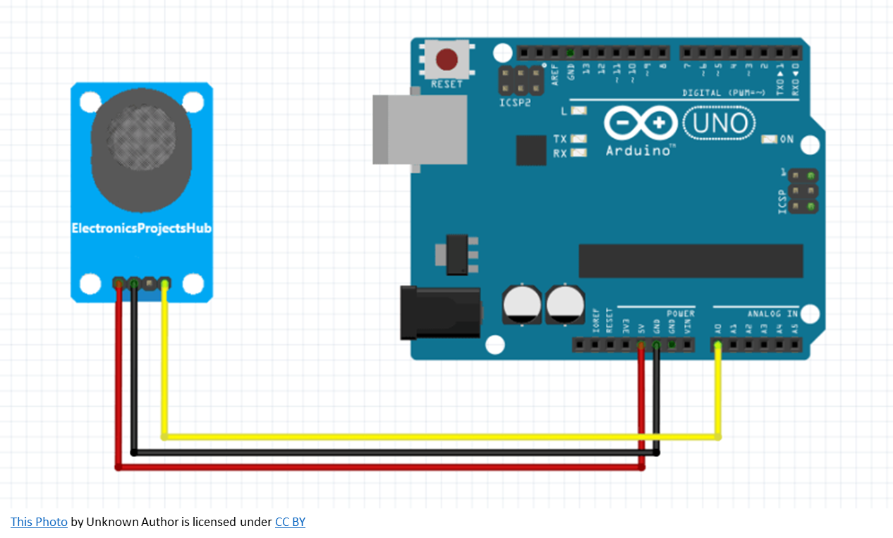
Methodology
The alcoholic test of the driver can be detected by interfacing the MQ3 sensor with the Microcontroller in which MQ3 senses the presence of ethanol in the air.
Pioneering work for developing Vehicle features, saving major crash deaths. With the help of various technology, sensors, devices, and electronic equipment we will complete this model.
Very less number of Cars and motor vehicles are using these features to make prevention. To initiate with this device we will make a prototype with our proficiency, knowledge known, and technology. As we all know Microcontroller helps to make prototypes easily with some code and circuitry.

Slide 11
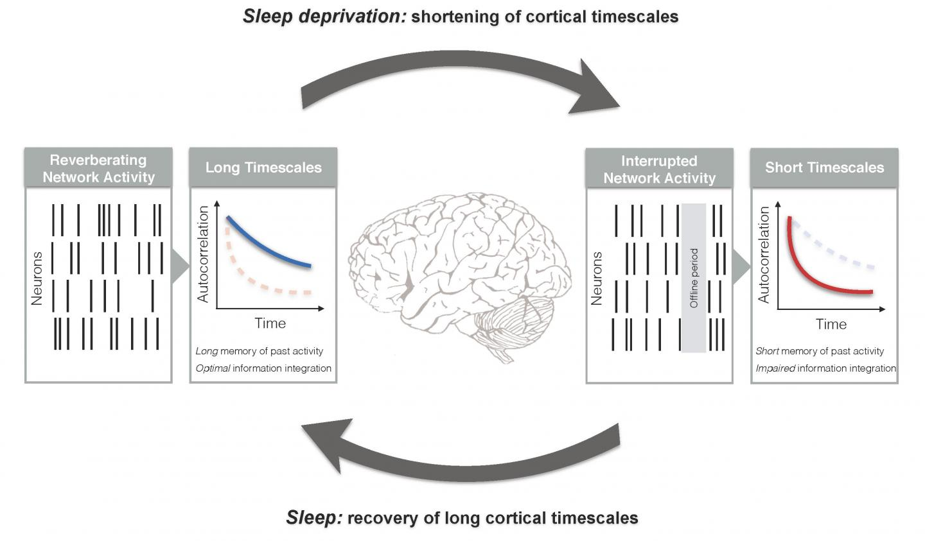
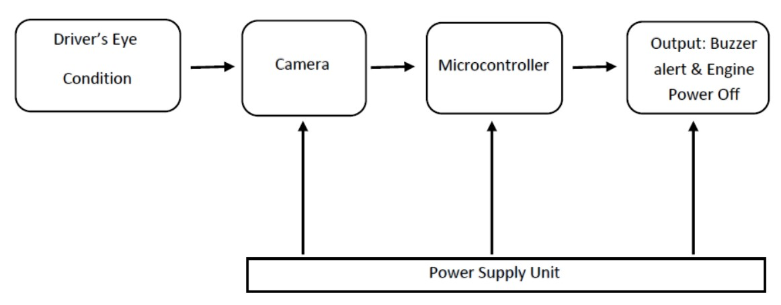
For Anti-sleeping monitor eye drop, pupil occlusion and eye closure via camera. There is a strong relationship between sleepiness and eye activity.

Slide 12
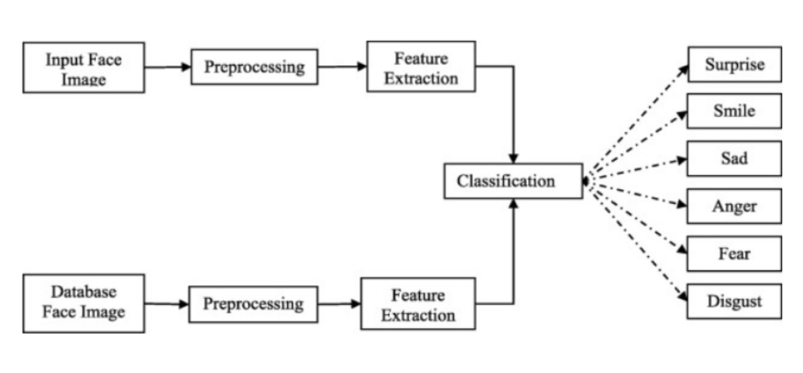
For face recognition: A smile on a human face shows happiness and it expresses the eye with a curved shape. The sad expression is the feeling of looseness which is normally expressed as rising skewed eyebrows and frowns. The anger on the human face is related to unpleasant and irritating conditions.
The expression of anger is expressed with squeezed eyebrows and slender and stretched eyelids. The disgusted expressions are expressed with pull-down eyebrows and a creased nose. The surprise or shock expression is expressed when some unpredicted happens.
Buzzer sound frequency is between 20hz to 500hz.
This is expressed with eye-widening and mouth gaping and this expression is an easily identified one. The expression of fear is related to surprise expression which is expressed as growing skewed eyebrows.

Slide 13
Pricing and Budget
S.NO. | PROCESS | PRICE STRATEGY
1 | Research and Analysis | 10000
2 | Design and Prototyping | 50000
3 | Development and Testing | 200000-300000
4 | Marketing and Launch | 100000-200000
5 | Contingency | 50000

Slide 14
THANK YOU

